Slide 1
DECENTRALISED PAYMENT SYSTEM
Secure Software Framework for financial transactions
Presented By: Srija Dhulipalla

Slide 2
Problem Statement
Traditional payment systems are centralized, relying on intermediaries, which can lead to higher fees, slower transactions, and security vulnerabilities.
There is a lack of transparency and trust, especially in cross-border payments involving multiple currencies.
Users want control over their financial assets without having to trust centralized institutions

Slide 3
Solution Overview
A decentralized payment system leveraging blockchain technology for secure, transparent, and fast transactions.
Users can send and receive payments directly using cryptocurrency without intermediaries.
Multi-currency support allows seamless handling of different digital assets.
How It Works:
Smart contracts facilitate secure transactions.
Users connect via a wallet (MetaMask) to interact with the payment system.

Slide 4
System Architecture
Frontend: Built with a modern web framework like React.js.
Blockchain: Smart contracts deployed on Ethereum or a test network.
MetaMask: For wallet integration, user authentication, and sending transactions.
Smart Contracts: Core logic for transactions, multi-currency handling, and data storage.
Network: Use of Truffle, Ganache (for local development), and Test Network (Rinkeby/Goerli).

Slide 5
Key Features
Multi-Currency Support:
Users can manage and transact with multiple types of cryptocurrencies.
Each supported currency is handled by a different smart contract.
Decentralized Architecture:
No central authority. All transactions are handled via smart contracts and stored on the blockchain.
Security & Transparency:
Transactions are secure and immutable, visible to all parties via the blockchain.
MetaMask Integration:
Easy wallet connectivity for seamless transactions.
User-Friendly Interface:
An intuitive frontend interface that makes interaction with smart contracts accessible to users.

Slide 6
Challenges
Technical Challenges:
Smart contract development and handling multi-currency support.
Ensuring the security of transactions in a decentralized setup.
Integrating MetaMask for a seamless user experience.
Solutions:
Rigorous testing with Truffle and continuous debugging.
Implemented best security practices, including reentrancy protection and safe math operations.
Followed a modular smart contract structure for flexibility and easier updates.

Slide 7
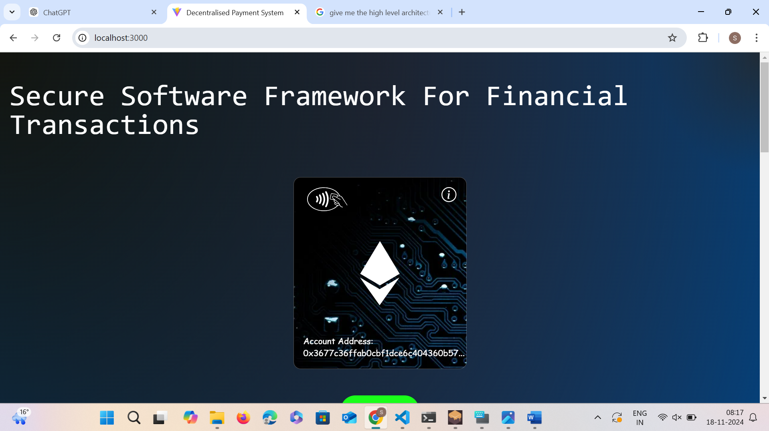

Slide 8
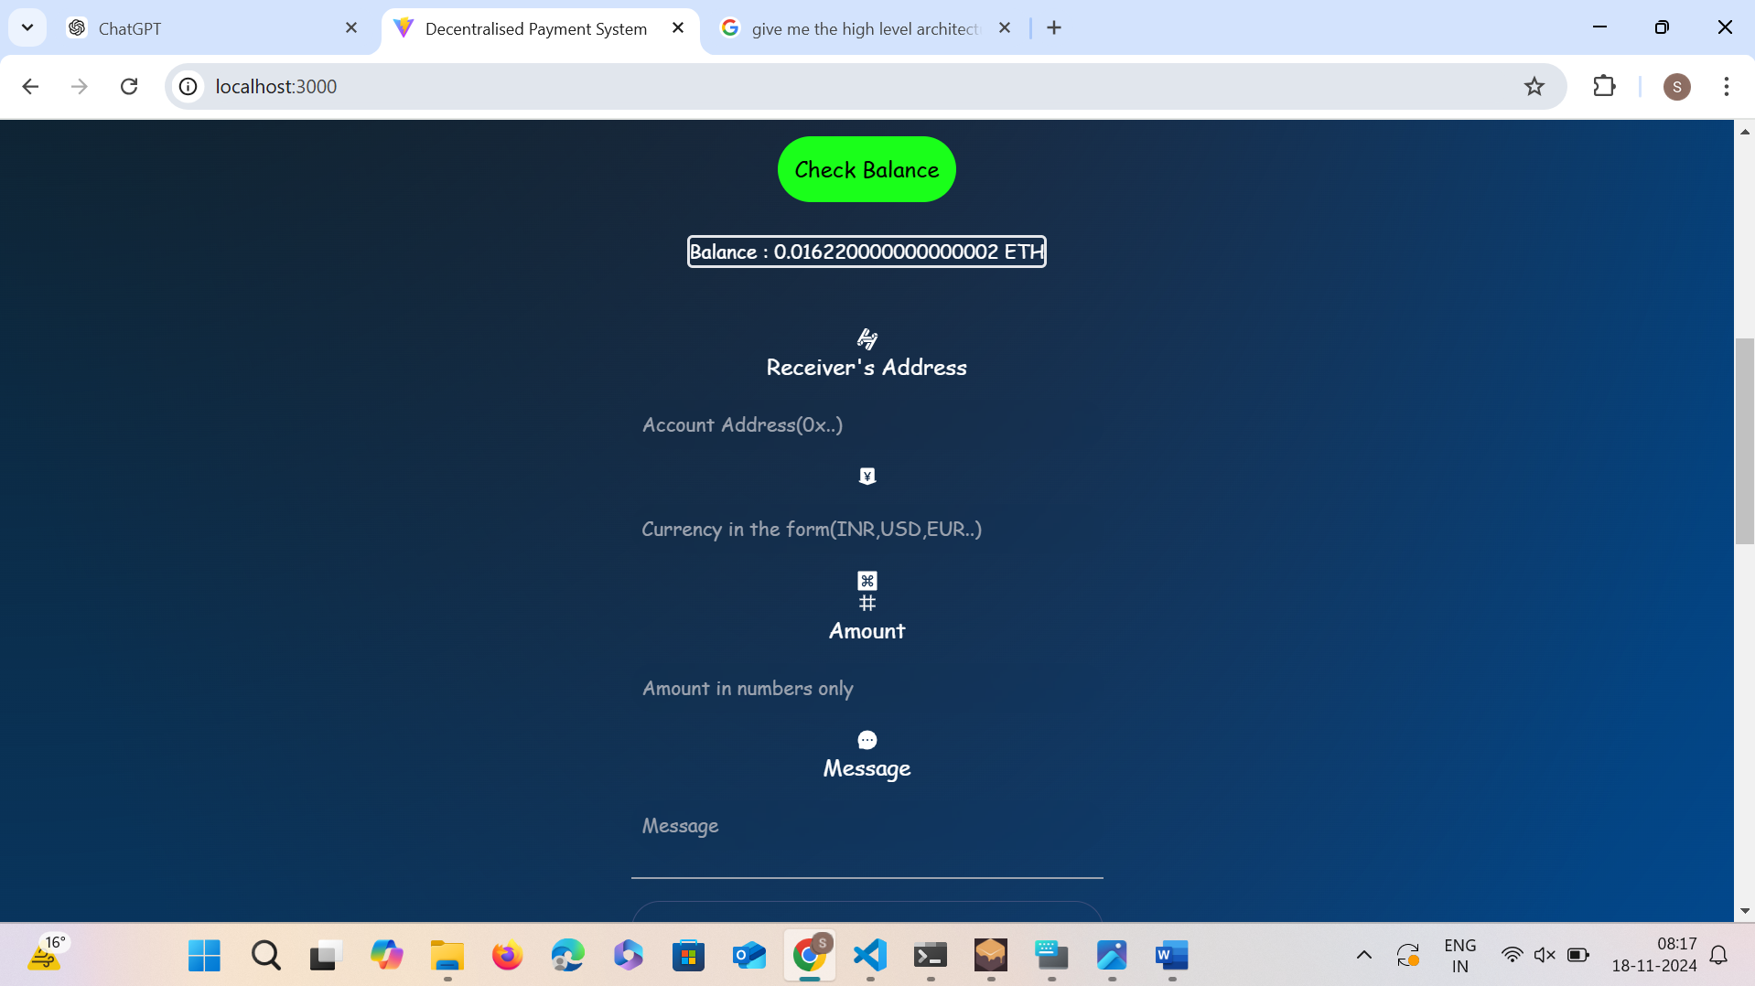

Slide 9
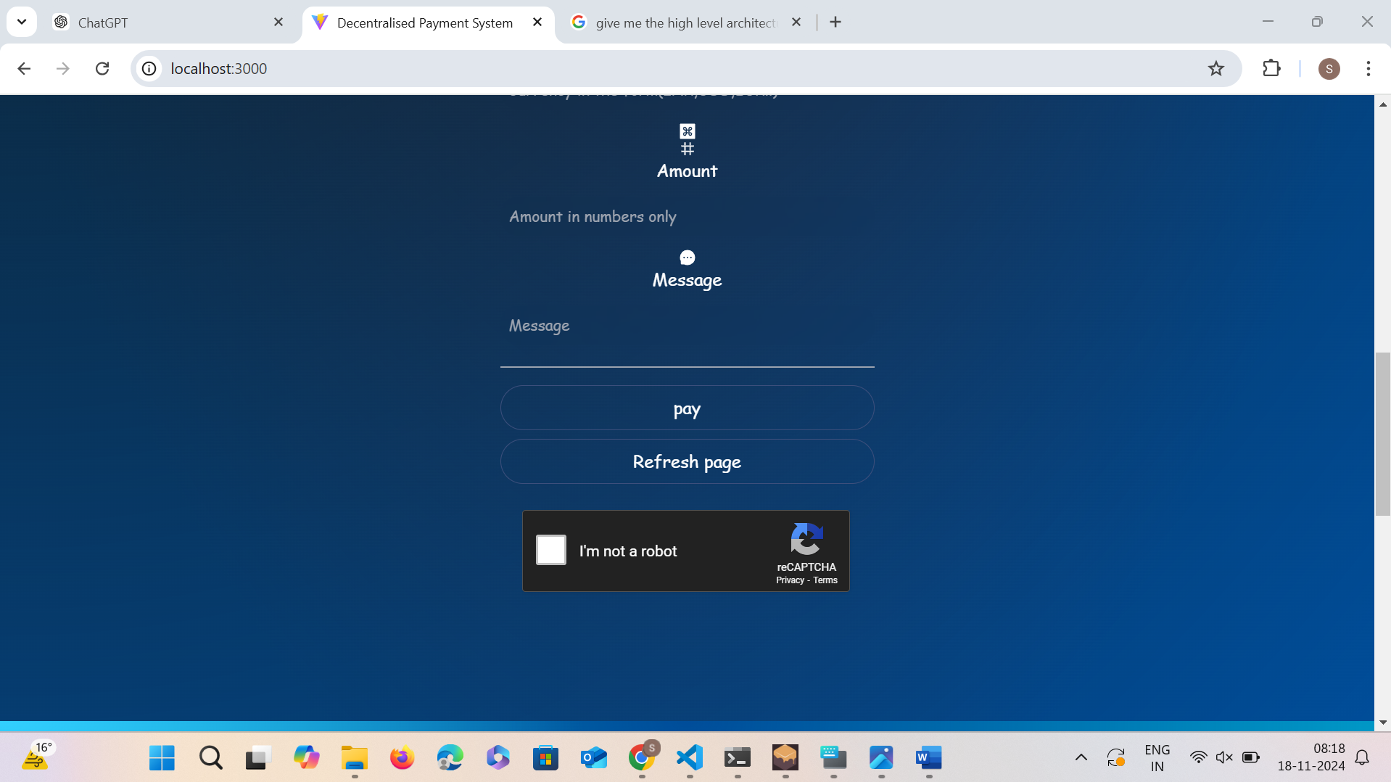

Slide 10
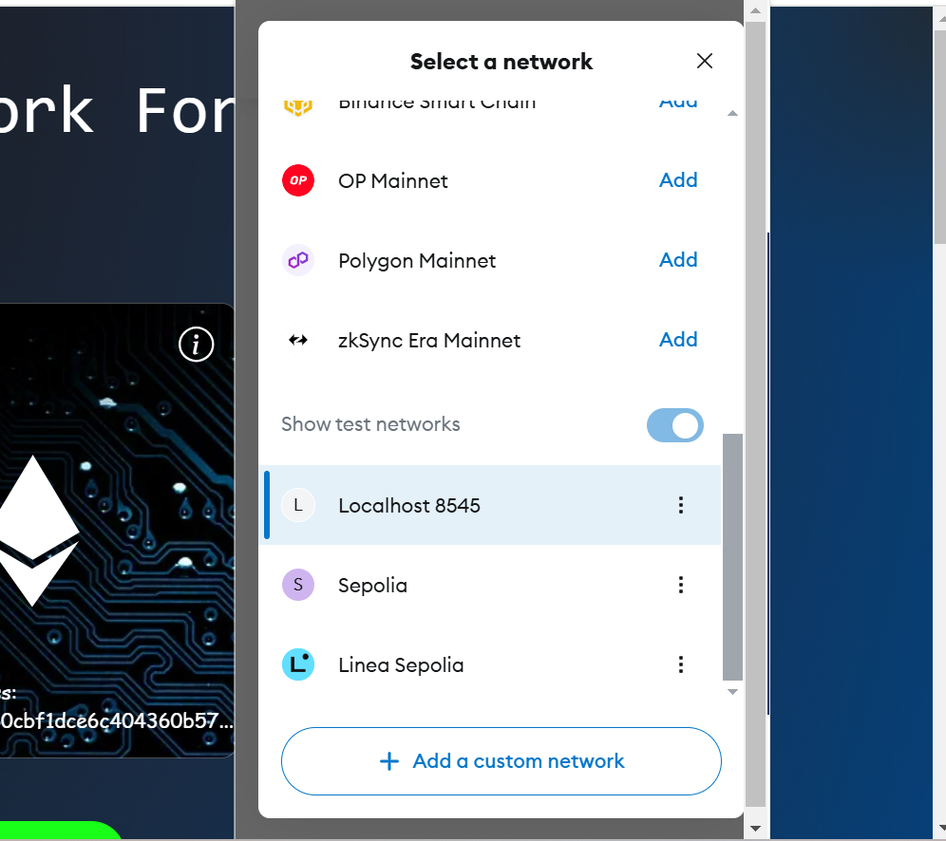

Slide 11
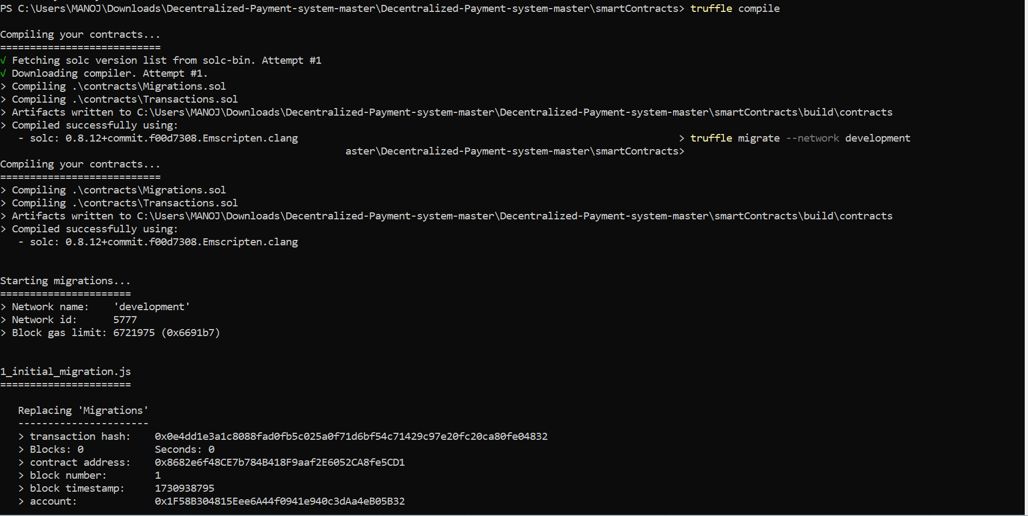

Slide 12
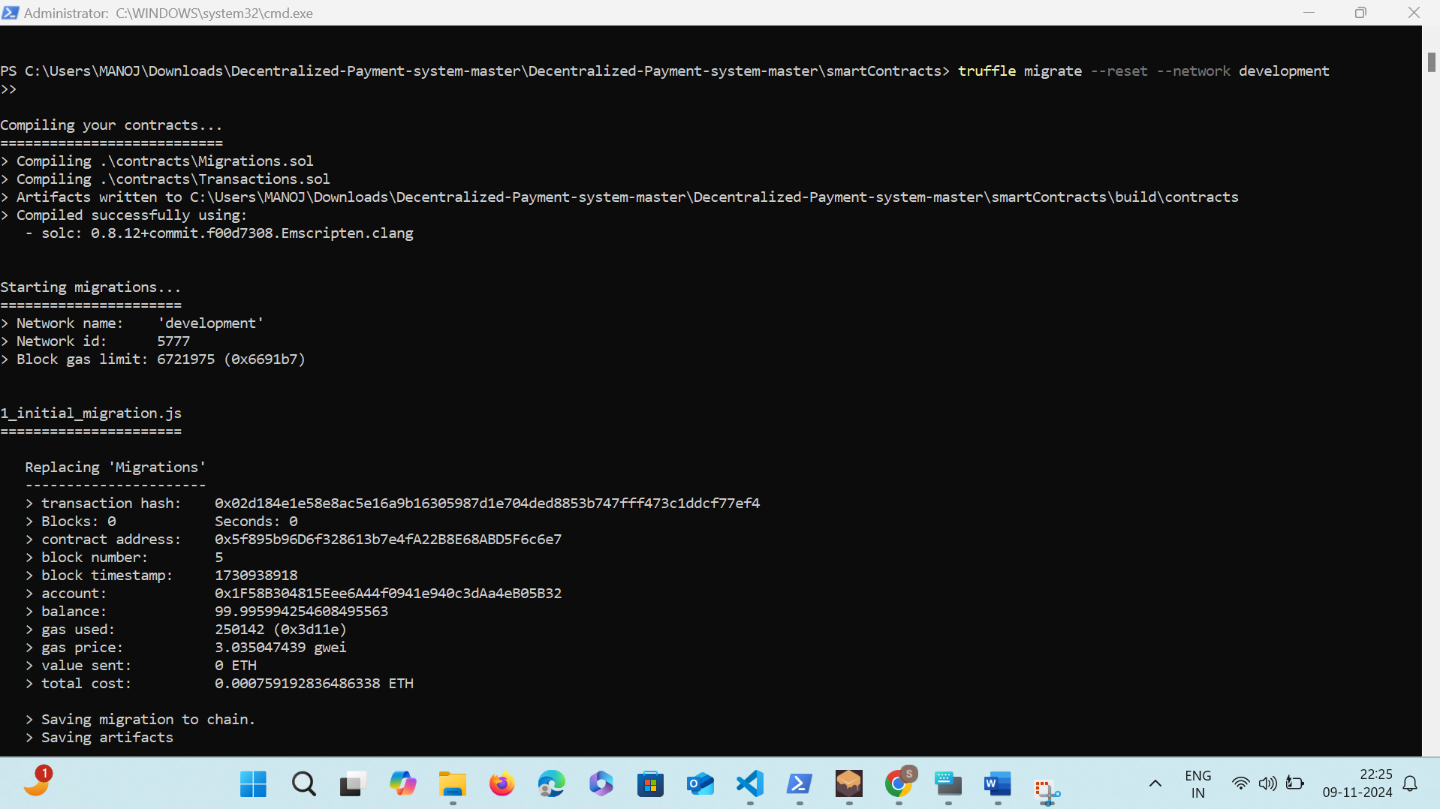

Slide 13
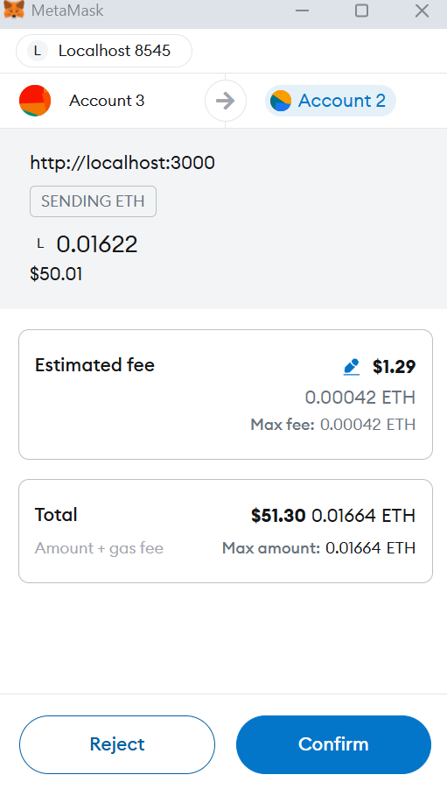
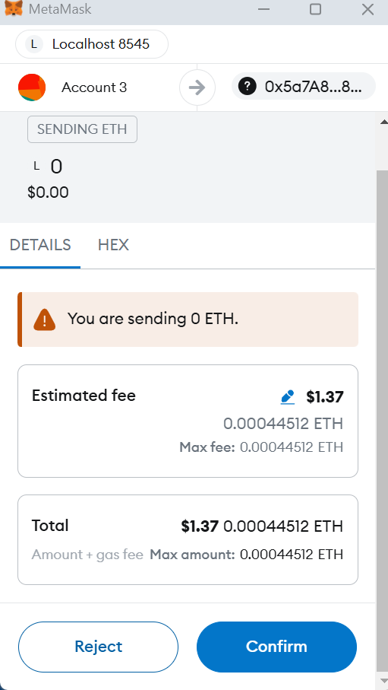

Slide 14
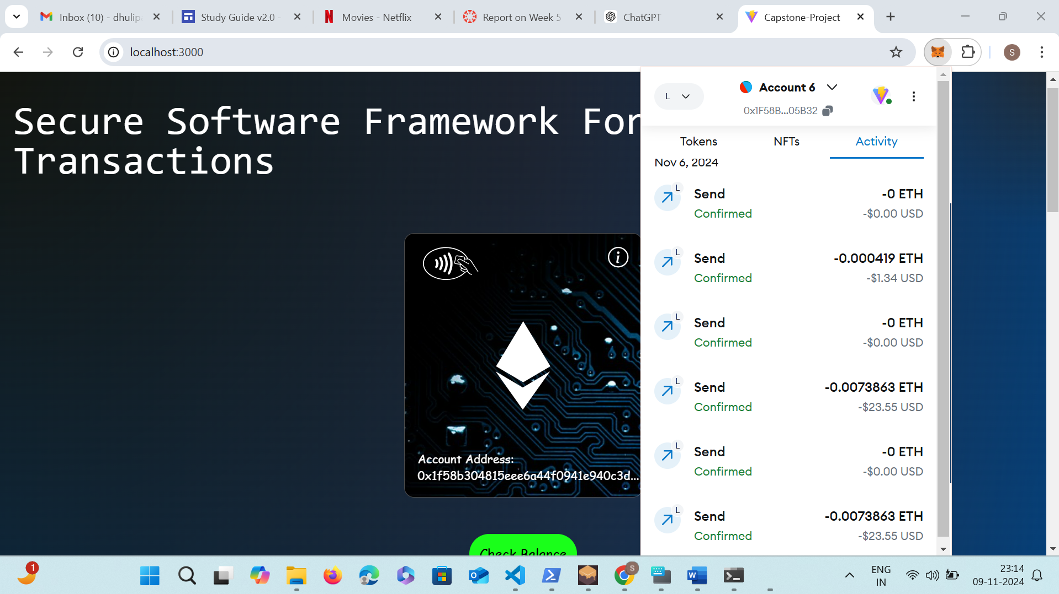

Slide 15
Future Enhancements
Additional Cryptocurrency Support:
Expand to support more cryptocurrencies and integrate with new blockchains (like Binance Smart Chain).
Improved User Interface:
Enhancements to the frontend for better user experience.
Advanced Security Features:
Implement multi-signature wallets for enhanced security.
Additional smart contract auditing for security vulnerabilities.

Slide 16
Demo Link:
https://umsystem.hosted.panopto.com/Panopto/Pages/Viewer.aspx?id=a8c07a2e-3f0b-44a3-aa6f-b22d001f6184

Slide 17
Q&A

